Slide 1
Facilities + Physical Infrastructure

Slide 2
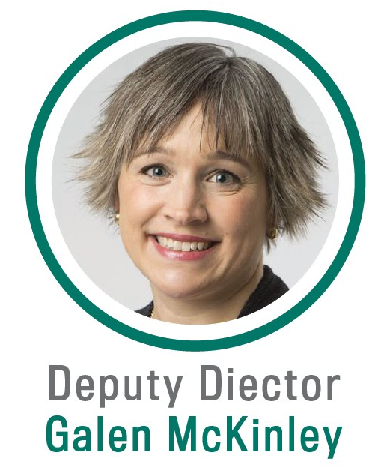
Professional Experience and Education
  Professor of Earth + Environmental Sciences, Columbia
    Previously Professor of Atmospheric + Oceanic Sciences, Wisconsin
  PhD, Climate Physics + Chemistry, MIT
Expertise
  Ocean carbon cycle, feedbacks with climate
  Ocean + climate modeling
  Data science
Synergistic Activities
  The Oceanography Society, Councilor, 2020-present
  JASON Advisory Group, 2015-present
  Diversity Committee chair, EES department, 2019-present
  Co-chair for undergrad education, Wisconsin AOS, 2010-15
2

Slide 3


Implementing our Vision
LEAP forward in the reliability, utility, and reach of climate projections through synergistic innovations in data science and climate science.

Slide 4
My Presentation Will Explain:
Institutional commitments necessary for achieving cross-institutional and sustained impact
LEAP’s dedicated headquarters spaces’ role in broadening participation + transferring knowledge

Slide 5
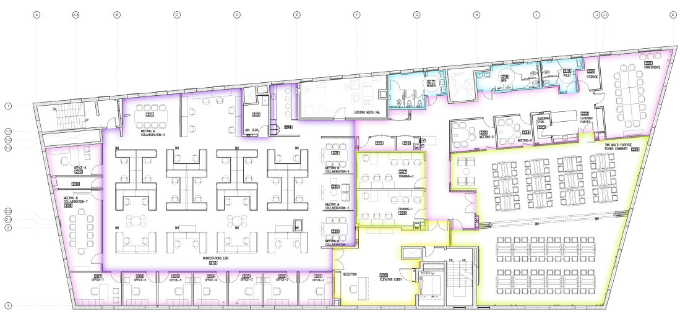
LEAP’s Headquarters are Large + New
Space
  3 offices
  10 workstation cubicles
  16-person conference room
  70-person training space
Opening December 2021

Slide 6
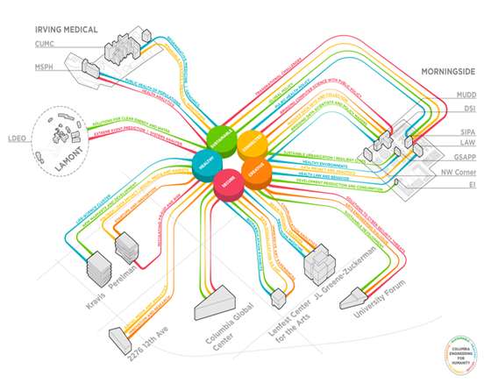
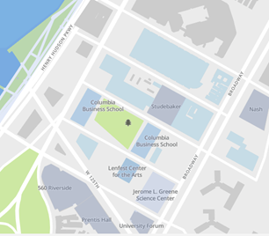


LEAP is Strategically Placed in the New Manhattanville Campus

Slide 7

LEAP will Leverage Future Columbia Climate School’s Visibility
July 2020: Trustees unanimously approve future creation of Columbia Climate School
  First school ever devoted exclusively to climate
Centralizing coordination + visibility of existing efforts
across Columbia
  Potentially including LEAP
5 LEAP members involved in Climate School
pre-planning
  Chief Equity Officer Cogburn on
  new Design Committee

Slide 8

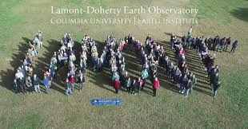
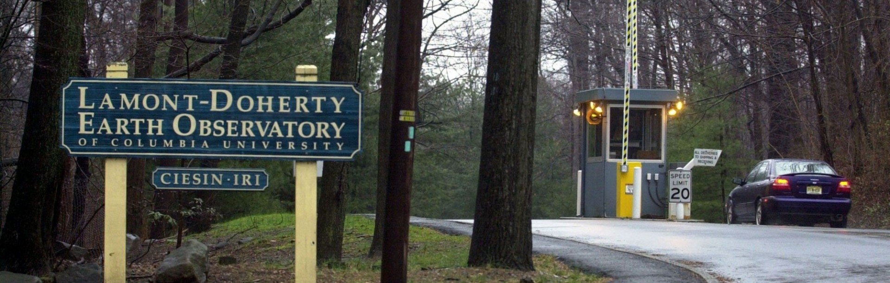
Lamont-Doherty Earth Observatory Commits Work + Meeting Spaces
Campus Square Footage
Buildings: 378k
Offices: 82k
Labs: 98k
Auditoriums Sizes for LEAP Meetings (by # seats):
200, 180, 100, 50, 25
Free shuttle transportation between
Morningside + Lamont campuses
  10x/ day
All climate science postdocs + students
have committed workstations
  In addition to workstations at LEAP’s
  Manhattanville headquarters

Slide 9
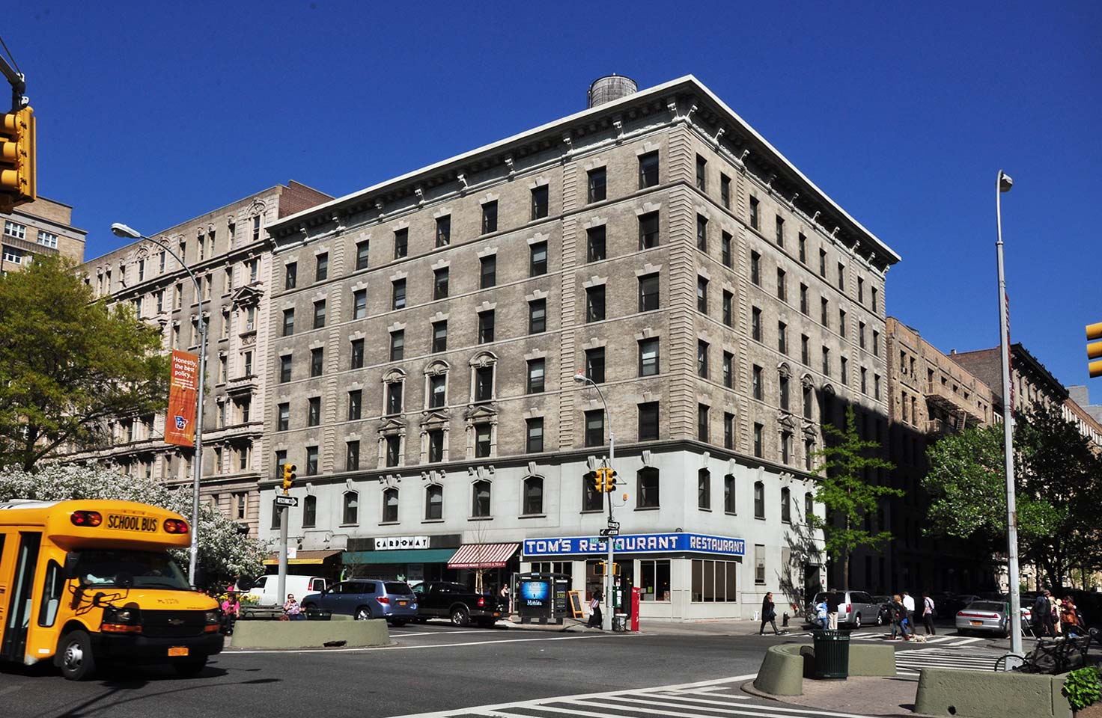
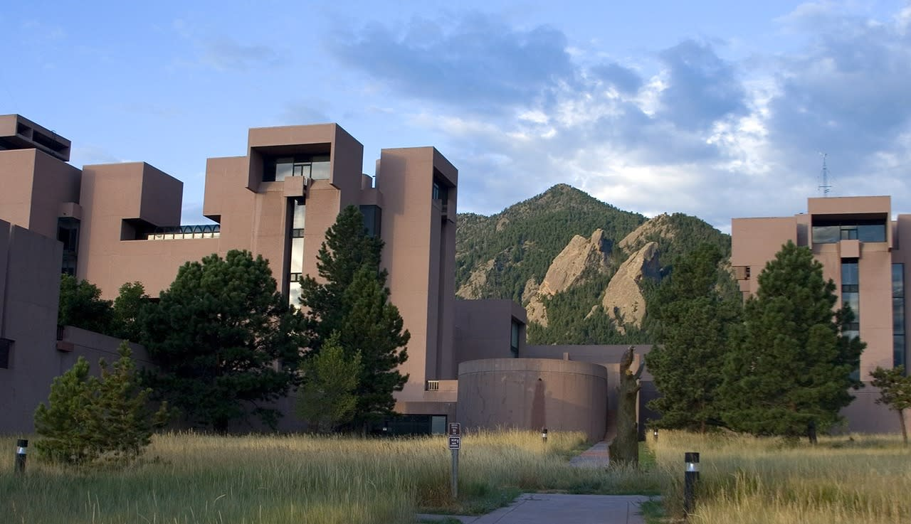
LEAP Researchers take Hold Short-, Medium-, and Long-term Visits to Federal Labs
NASA GISS
4 blocks south of Columbia
40 Columbia researchers semi-permanently visiting
  Including 3 LEAP senior personnel
Since 2010: 100 Columbia semi-permanent visits
Shared offices distributed as projects come online
Will permanently host 3 LEAP research scientists
NCAR
100+ short (3-week) researcher visitations per year
5-10 long faculty visitations per year
Dedicated desk space + supercomputer access to all visitors
LEAP: 4-6 grad students + 4-6 postdocs visiting NCAR each summer
  Travel + housing in NSF budget request

Slide 10
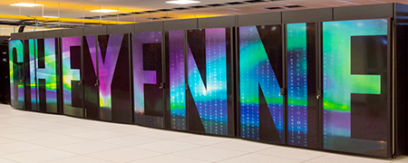
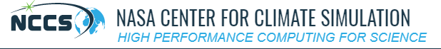


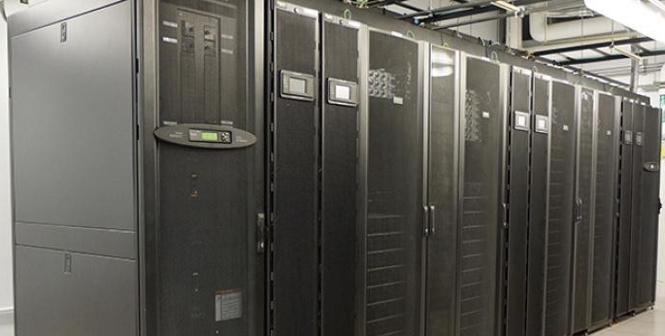
Partner Institutions Commit Ample Computational Resources to LEAPangeo
NCAR Computational + Information Systems Lab
145k-core “Cheyenne” supercomputer
5.34 petaflops
Will support LEAP through University Large Allocations
+ CESM Working Group Allocations
NCAR Wyoming Supercomputing Center installed in 2022
NASA Center for Climate Simulation
129k-core “Discover” supercomputer
6.8 petaflops
GISS has access to 30% of capacity
Industry Commitments
Microsoft + Google donating sufficient cloud credits to support all LEAP activities
Columbia High-Performance Computing
3.8k-core “Terremoto” cluster
137 nodes, 3,288 cores
Governed by faculty committees
Supported by 7 full-time engineers

Slide 11
Questions?

